Slide 1
Investor Holding Analyzer

Slide 2
Purpose:
This system is meant to process historical shareholding information of companies to come up with analytics for individual investors.
A common dilemma facing private equity investors is to decide which companies to invest in. One of the best ways to learn is by mimicking the experts.
In our project we have primarily focused on how user can invest conveniently into the share market.

Slide 3
Users must have access to the heat chart by which they can analyse the present scenario of the market and invest accordingly, where hot (popular) and cold (unpopular) investments can be studied.
For further guidance they can also have access to the top investors portfolios and their data from previous quarters.

Slide 4
Personalized list:
They can also create and update their personalized list in which they can keep track of investors they choose to follow.
If many investors from a user’s personalized list have invested in the same company, i.e. have reached consensus, then this information will also be given to user.

Slide 5
Analysis parameters:
1. Sector wise: Data of all investments will be classified in sectors and performance of each sector such as finance, banking, automobile etc. can be studied.
2. Company wise: Data of all investments for each company will be provided to users and they can study the rise or fall of share prices for each individual company.
3. Holding & Market Share: For each company, amount and percentage of holding for each investor will be shown.

Slide 6
4. Market Value: The data of a holding’s market value can be studied over quarterly period, sector or company wise.
5. Heat Map of Sector: Heat maps indicate how popular a sector is with investors and users can see which sectors are in demand.
6. Heat Map of Companies: Heat maps indicate how popular a company is with investors and users can see which companies are in demand.

Slide 7
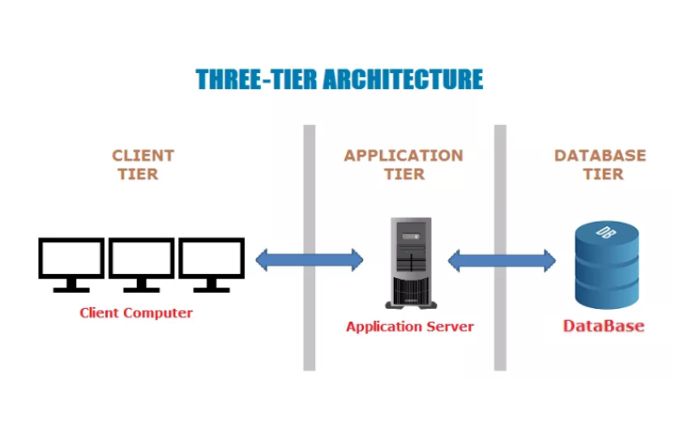
Architecture:

Slide 8
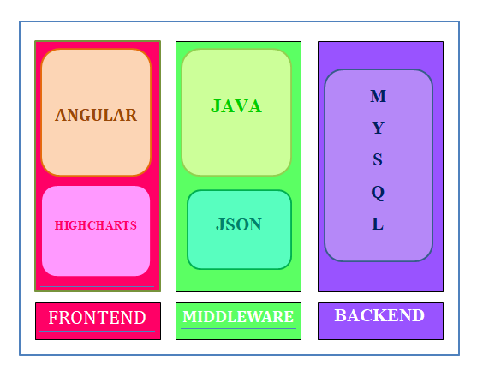
Technology Stack:

Slide 9
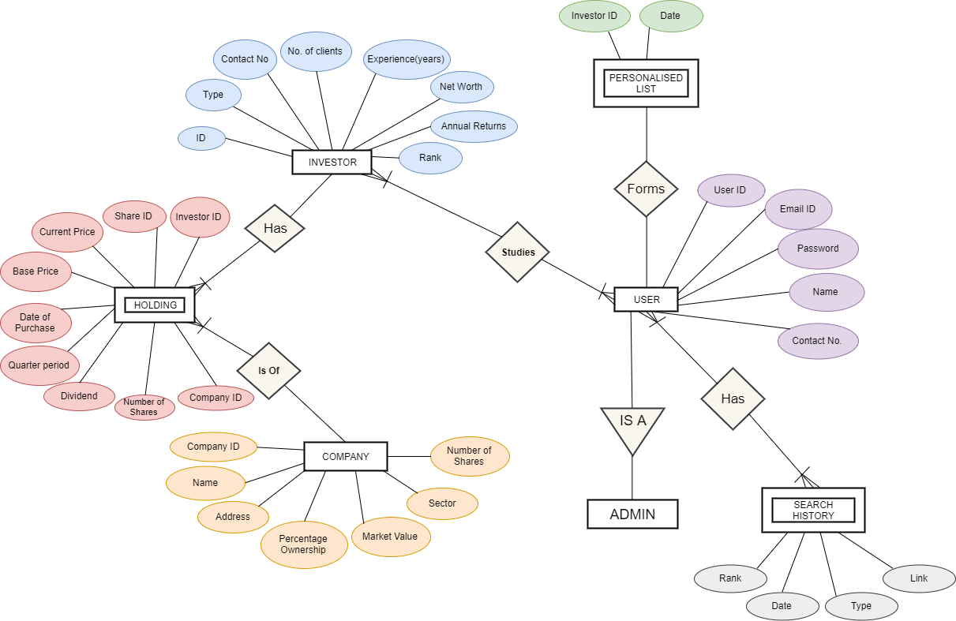
E R Diagram:

Slide 10
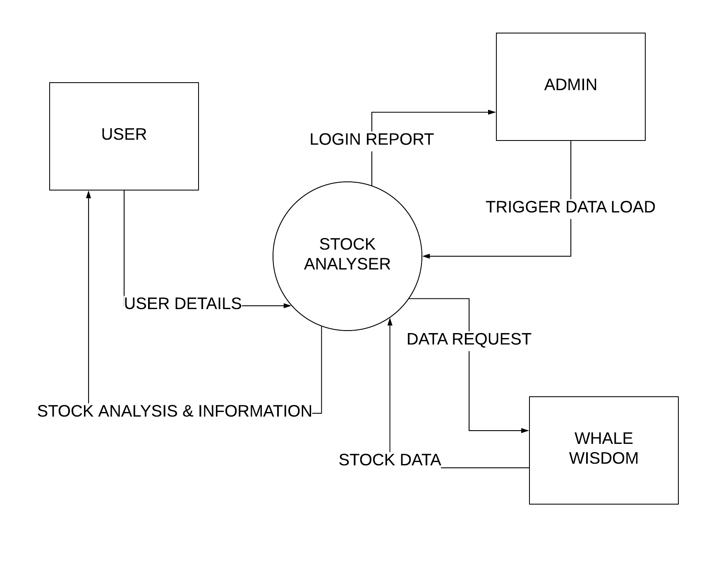
DFD Level 0

Slide 11
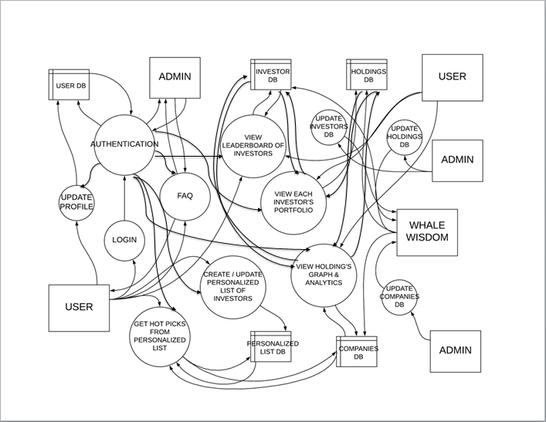
DFD Level 1

Slide 12
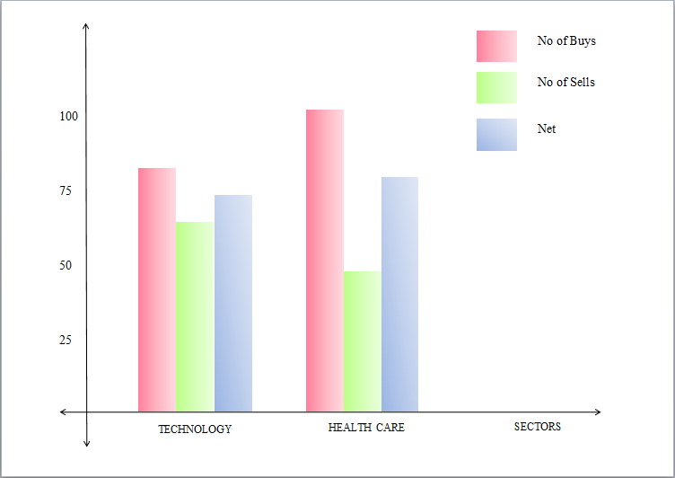
Charts:

Slide 13
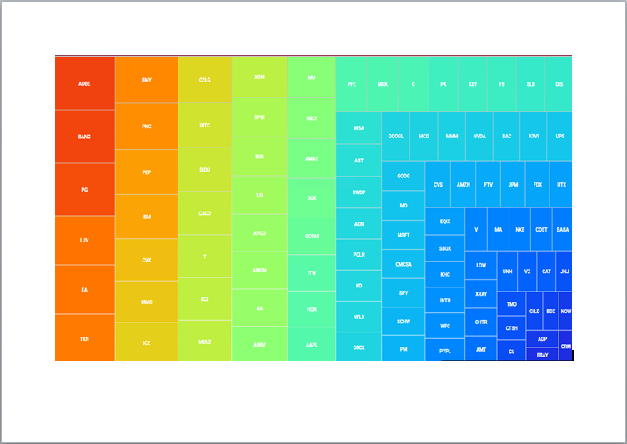
Heatmap

